Slide 1
Milky Way Bulge PSF Photometry Visualization
Group-1
Mentor:
Dr. James Abello
TAs:
Praneeth Thota Naveen Meyyappan
Harshini Bonam
Kanya Kreprasertkul
Yifan Liao

Slide 2
1.
Introduction
Let’s start with the...

Slide 3
Why? Sky is interesting!
We escape into gazing at it, turning to the boundless universe.
Time taken(traverse countably celestial bodies) a person’s entire life.
So, our spectacular interstellar journey may start with research on the
Brightness
Wavelength Spectrum
to scoop the secrets of the stars at the center of the galaxy, starting with analysis of a huge data.
♾
>>

Slide 4
2.
Data Set Description

Slide 5
Size of about 100 GB
~600 million records
representing
613,723,417 stars
of near IR Bulge area of the Milky way Galaxy
Notes:
Each record represents a star

Slide 6
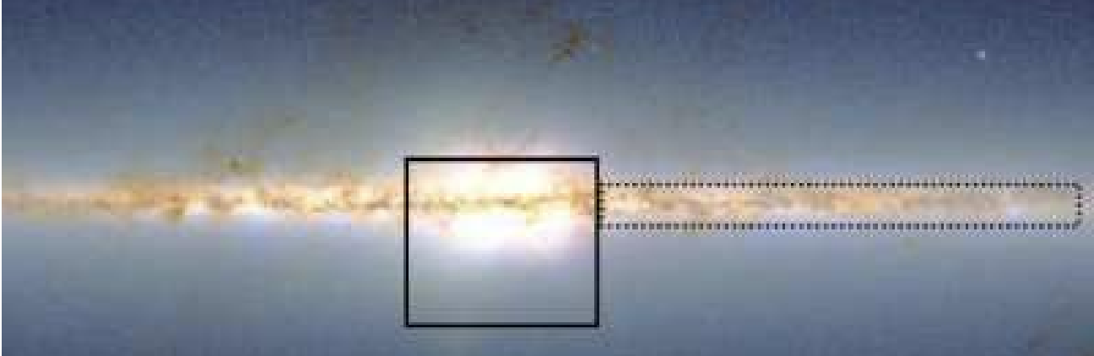
MASS map of the inner Milky Way showing the VVV bulge

Slide 7
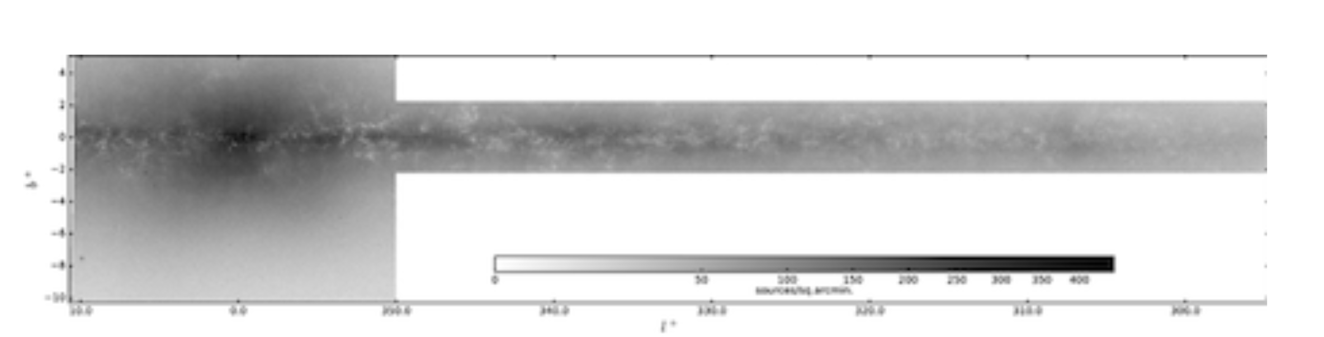
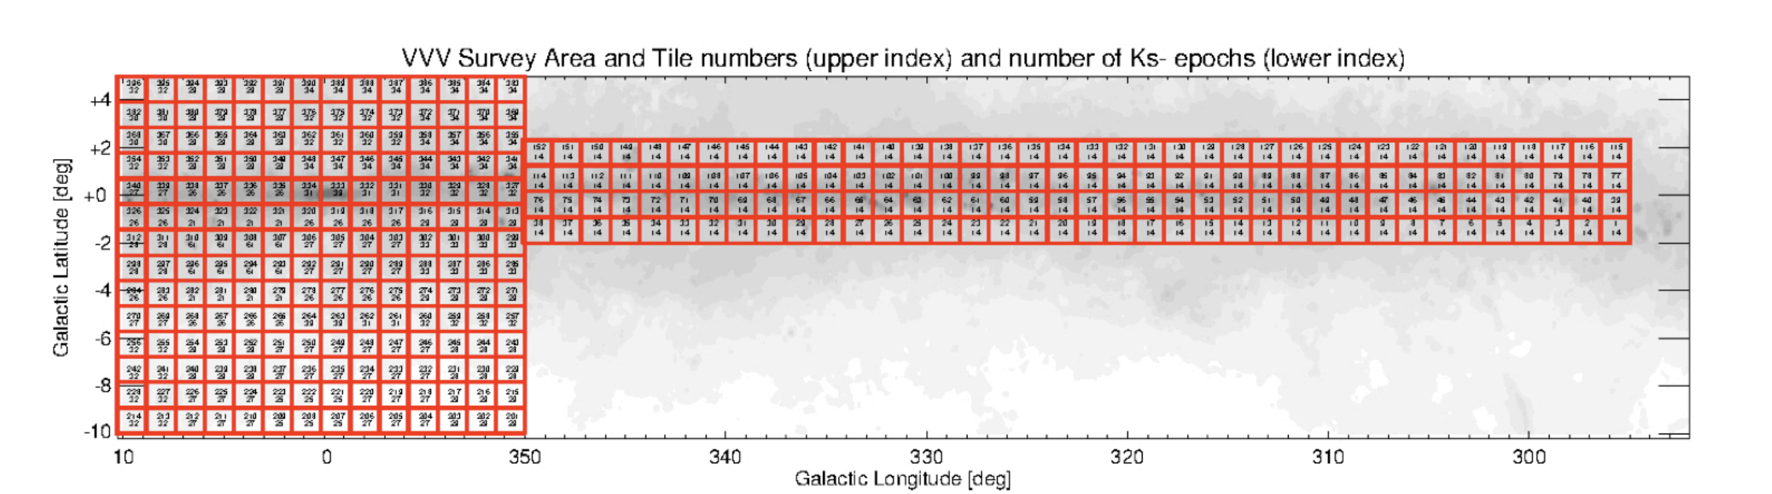

Slide 8
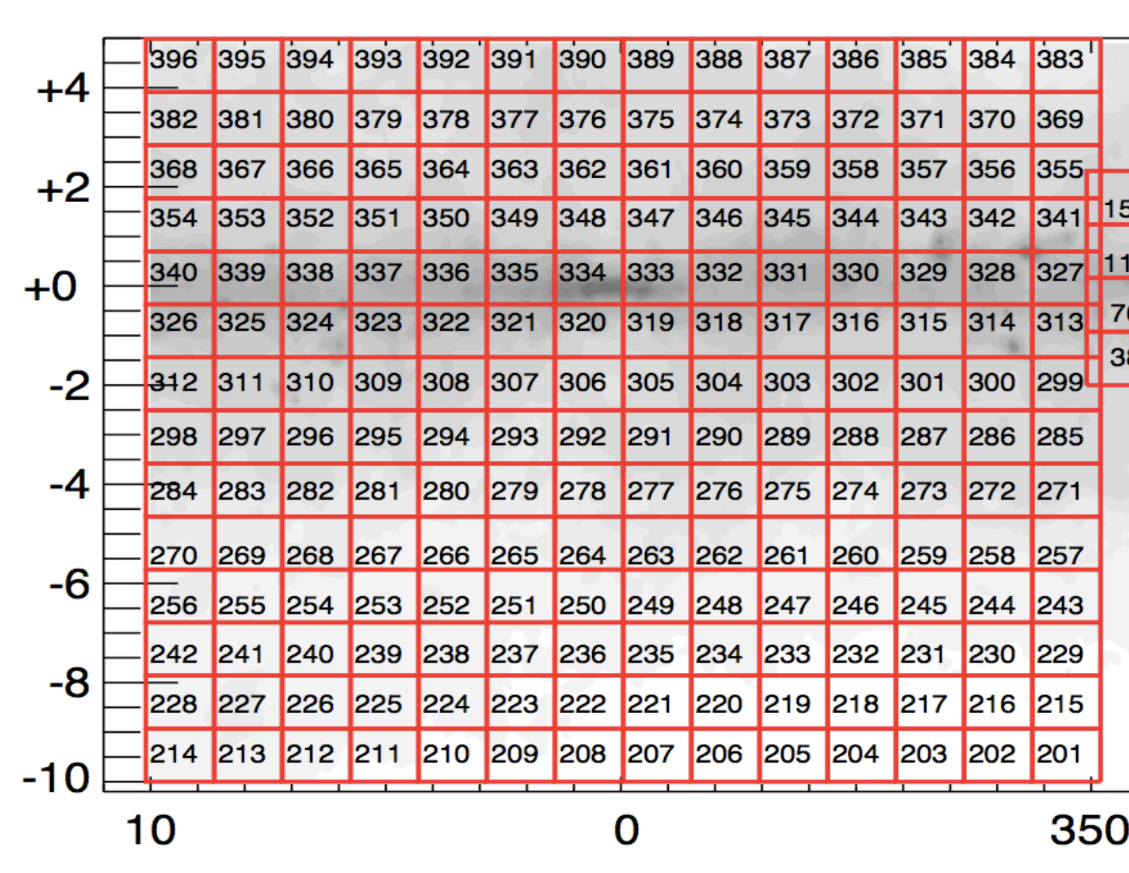

Slide 9
Data Set Description
Format
Our data set is based on a astronomical catalog released by the European Southern Observatory (ESO).
FITS
Flexible Image Transport System

Slide 10
Data Set Description
Collected by VIRCAM on VISTA 4-m telescope
~300^{o2} of the inner near IR Milky way galaxy
3912 Images
196 tiles
~1.5º x 1.2º sky coverage per tile

Slide 11
Data Set Description
Data is at rest
1 Entity – 0 Relationships
20 Columns :
source ID (primary key)
4 columns of its spatial position
Galactic Latitude, Longitude
Right Ascension, Declination
2 columns of its brightness.
J and Ks

Slide 12
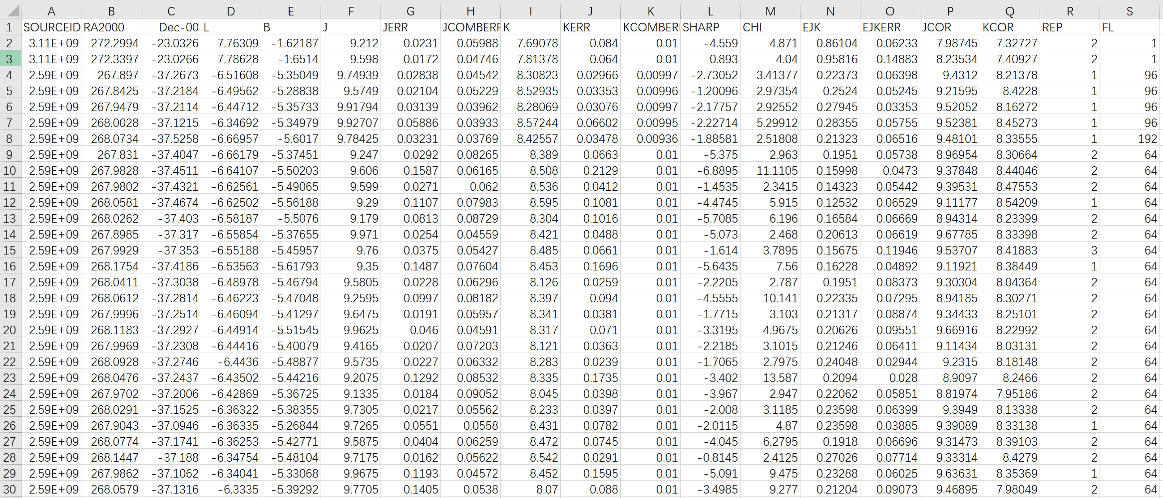
2. Data set snippet
A screenshot of selected columns of our data set

Slide 13
A screenshot of selected columns of our data set

Slide 14
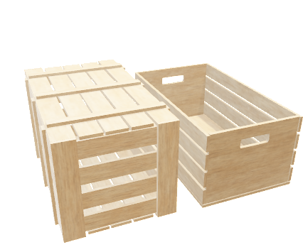
3. Data storage

Slide 15
Data Storage
Data download
Script provided
Science Portal of ESO website – with permission.
Data Storage and access
LCSR at Computer science department, Rutgers University – with permission.

Slide 16
4. Fundamental questions addressed:
Inputs:
Stars tile number
Features (number of stars, positions and brightness)
Outputs:
Count of number of stars.
City view of star buildings.
Graph view of star buildings.
Minimum, Maximum and Mean of features.
Bar chart of feature distributions

Slide 17
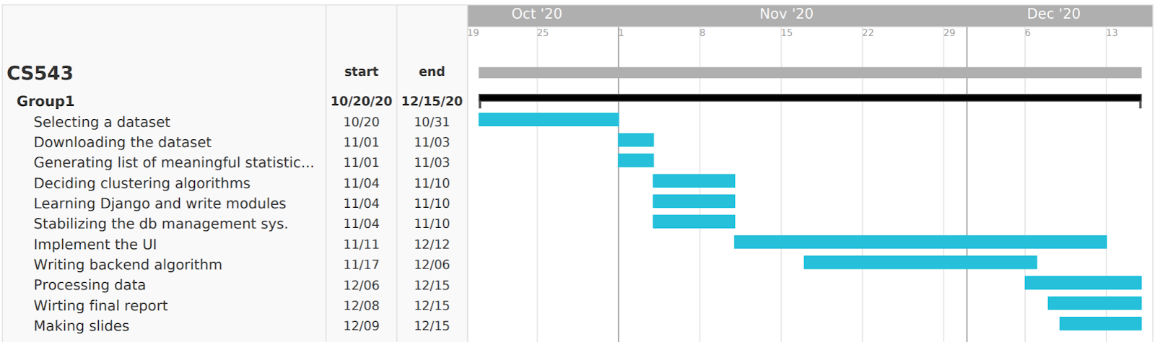
5. Gantt Chart of Project timeline

Slide 18
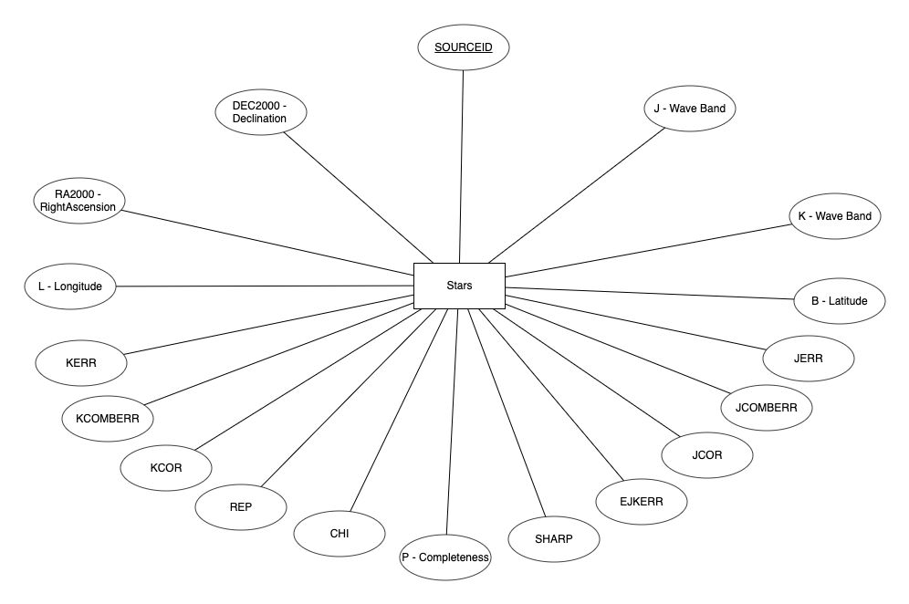
6. Entity Relationship Diagram

Slide 19
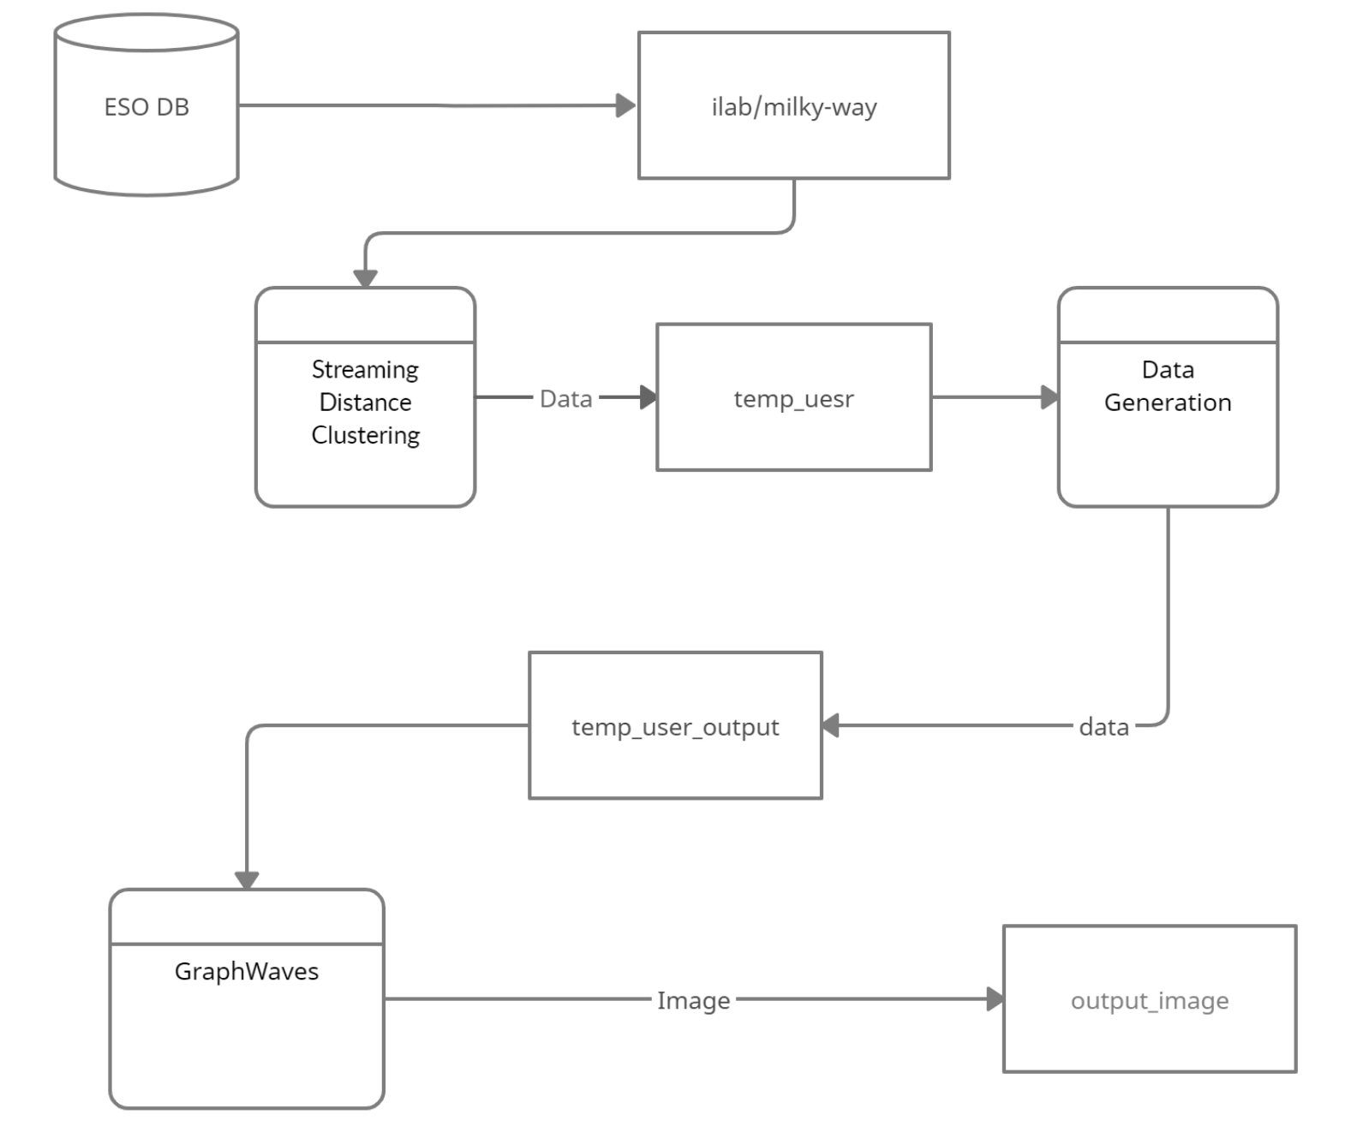
7. Data Flow Diagram

Slide 20
8. Interactivity
Web Application
Search box
Feature selection buttons
Interactive plots with
Labels
Pan
Zoom
Reset axes,
Auto highlights, etc.

Slide 21
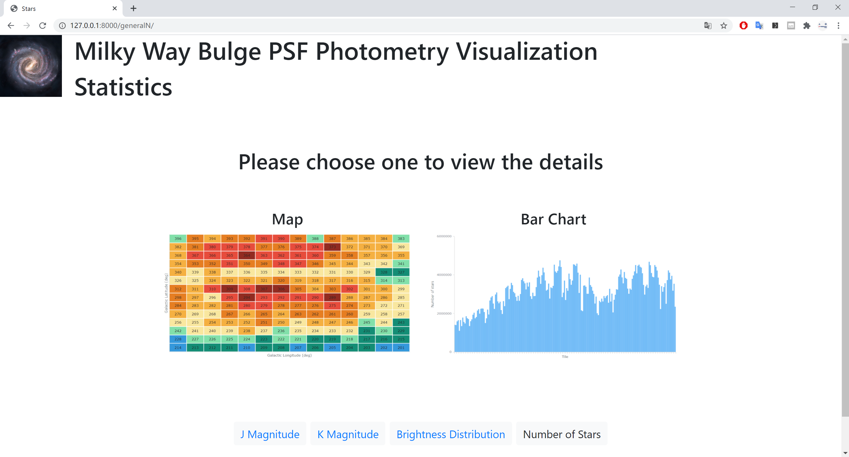

Slide 22
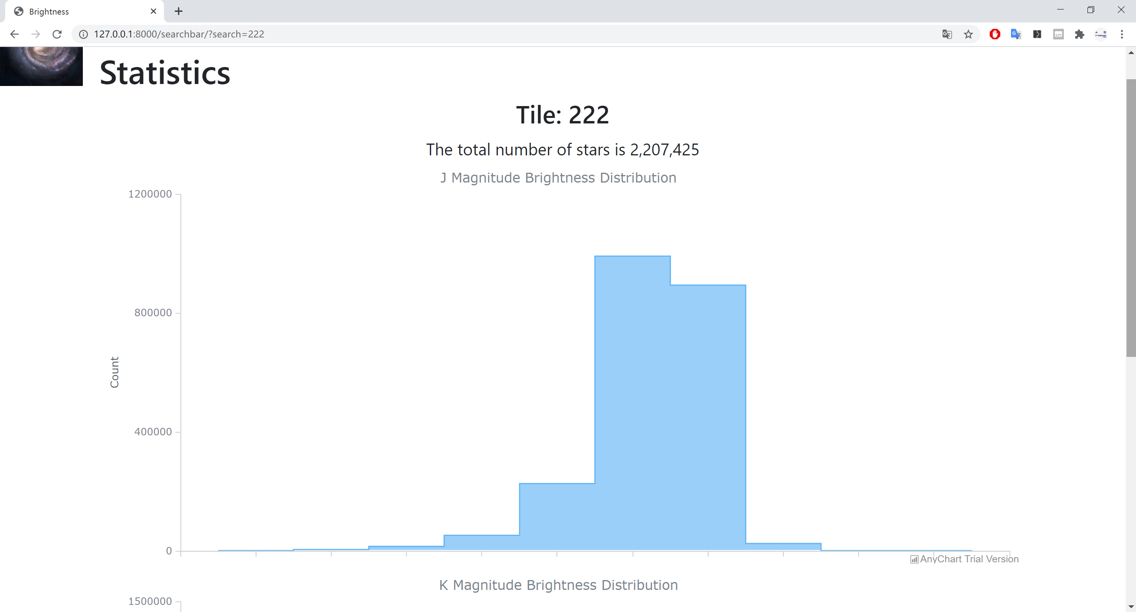
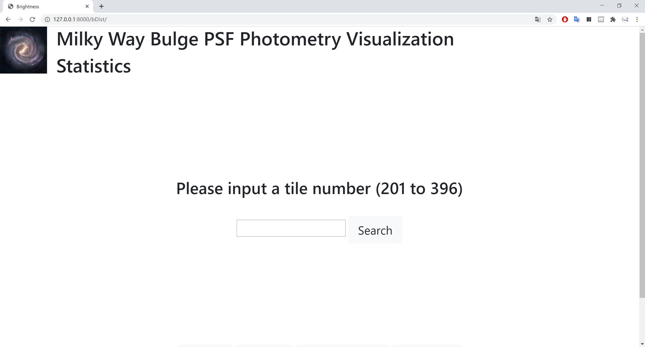
8. Interactivity

Slide 23
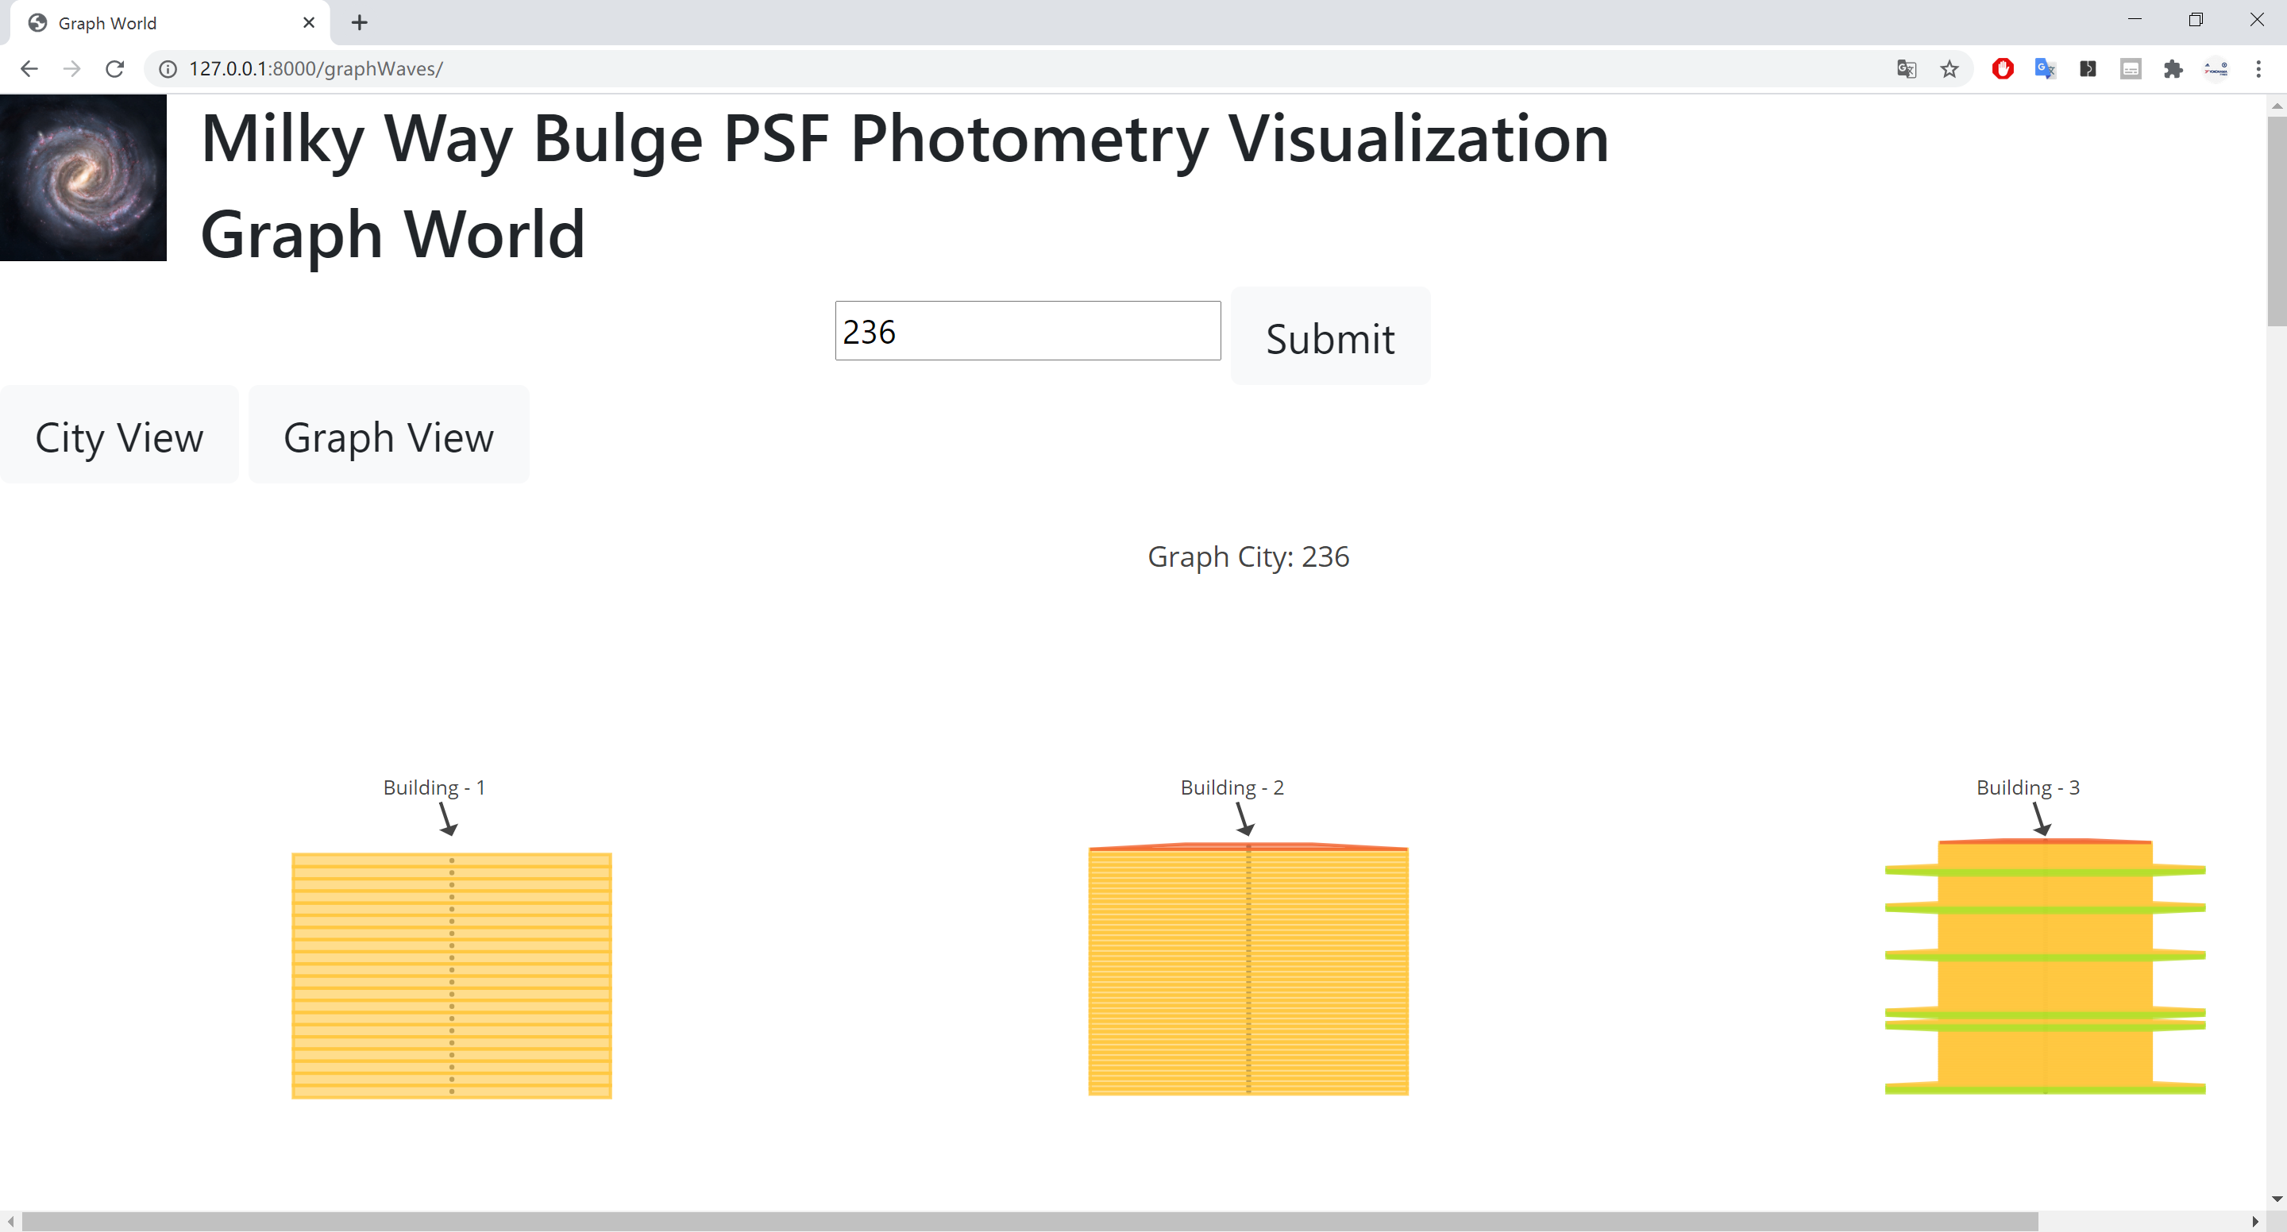

Slide 24
9. Mode of Processing and tools
Spark Environment (PySpark)
Django Webapp Development
10. Users
Naive users and Students
Technical users : Astronomers and Statisticians

Slide 25
10. Algorithms, libraries and database tools we are planning to use

Slide 26
Graph waves
Graph Partitioning Algorithm and K-means Algorithm
Python, HTML, CSS, & JS.
Spark, Astropy.io, D3.js and amCharts.js
Notes:
What algorithms, libraries, or database tools are you planning to use?

Slide 27
Graph waves
Graph Partitioning Algorithm and K-means Algorithm
Python, HTML, CSS, & JS.
Spark, Matplotlib, Networkx, Astropy.io, D3.js and anyCharts.js
Django framework
MVVM Architecture for client-server communication.
Notes:
What algorithms, libraries, or database tools are you planning to use?

Slide 28
Graph waves
Python, HTML, CSS, & JS.
Django framework
Graph Partitioning Algorithm and K-means Algorithm
Spark, Matplotlib, Networkx, Astropy.io, D3.js and anyCharts.js
MVVM Architecture for client-server communication and AJAX.
7. Display the results
Notes:
What algorithms, libraries, or database tools are you planning to use?

Slide 29
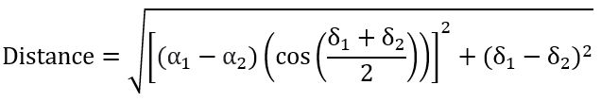
Graph Waves
Each star in each tile represents vertices in a graph
To create edge in a graph, the distance between the stars was calculated with the following equation, where right ascension (RA or α) and declination (DEC or δ) are the angular positions.
Then, we connected edge for the stars if their distance is less than 0.0001.

Slide 30
References
ESO milky way bulge PSF photometry dataset https://www.eso.org/qi/catalog/show/272
Dataset Description https://www.eso.org/rm/api/v1/public/releaseDescriptions/140
Graph waves algorithm http://ceur-ws.org/Vol-2578/BigVis7.pdf
ESO VVV exprtiment https://arxiv.org/pdf/1902.01695.pdf
The astropy library https://www.astropy.org/
VISTA Variables in the Via Lactea (VVV): The public ESO near-IR variability survey of the Milky Way https://arxiv.org/pdf/0912.1056.pdf
The VVV Phase 3 Data release VIRCAM https://www.eso.org/sci/publications/announcements/sciann17222.html, https://www.eso.org/sci/observing/phase3/data_releases/vvv_dr3.pdf
istance Between Two Stars http://spiff.rit.edu/classes/phys373/lectures/astrom/astrom.html
AnyChart https://www.anychart.com
Bootstrap https://getbootstrap.com
Plotly.js https://plotly.com/javascript/

Slide 31
Thanks!
Any questions?

Slide 32
Graph waves
Graph Partitioning Algorithm
Python, HTML, CSS, & JS.
Spark, Astropy.io, D3.js and amCharts.js
Django framework
MVVM Architecture for client-server communication.
7. Display the results
8. UI

Slide 33
8. UI

Slide 34
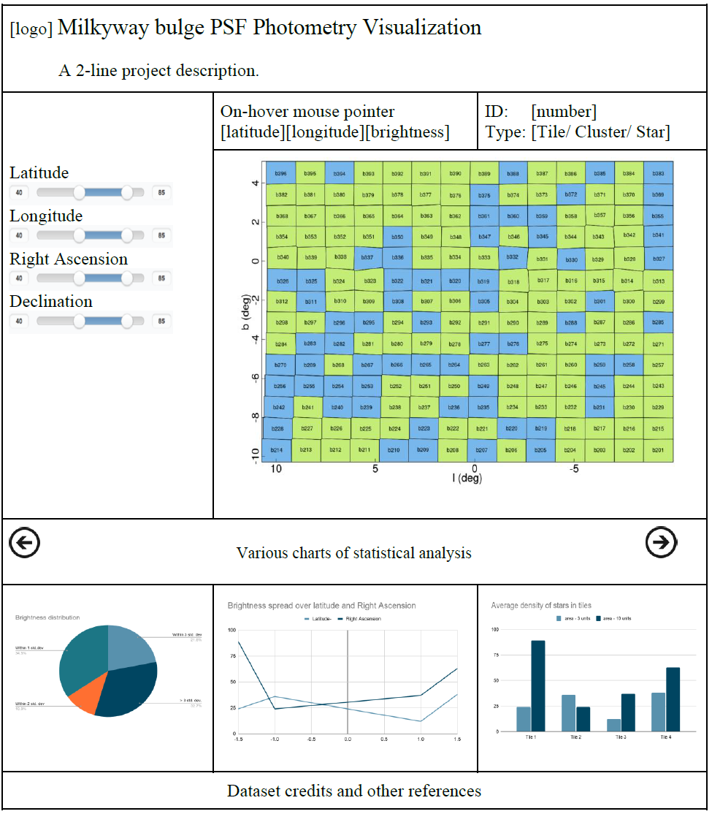
Tablet View
A Single Page Application (SPA)

Slide 35
Desktop View
A Single Page Application (SPA)
9. Distribution of Labor

Slide 36
9. Distribution of Labor

Slide 37
9. Distribution of Labor
Harshini Bonam
UI and background data processing
Kanya Kreprasertkul
Statistical analysis and background data processing.
Yifan Liao
UI, database management and reporting.
10/20
Selecting a dataset that will be processed and understanding the meaning of each column.
Harshini, Kanya & Yifan

Slide 38
10. Project Timeline
10/31
10/20
Download the dataset
Generate a list of statistics that can be meaningful for this dataset by processing a small part of the dataset.
Selecting a dataset that will be processed and understanding the meaning of each column.
Yifan & Harshini
Harshini, Kanya & Yifan
Kanya
Notes:
Distribution of Labor

Slide 39
10. Project Timeline
11/03
10/20
10/31
Decide on a good hierarchical clustering/partitioning algorithm
Learn using Django and write empty stubs and modules for the project
Selecting a dataset that will be processed and understanding the meaning of each column.
Download the dataset
Generate a list of statistics that can be meaningful for this dataset by processing a small part of the dataset.
Yifan & Harshini
Kanya & Harshini
Harshini, Kanya & Yifan
Kanya
Kanya, Yifan & Harshini
Notes:
Distribution of Labor

Slide 40
10. Project Timeline
10/20
10/31
11/03
Selecting a dataset that will be processed and understanding the meaning of each column.
Download the dataset
Generate a list of statistics that can be meaningful for this dataset by processing a small part of the dataset.
Decide on a good hierarchical clustering/partitioning algorithm
Learn using Django and write empty stubs and modules for the project
Yifan & Harshini
Kanya & Harshini
Harshini, Kanya & Yifan
Kanya
Kanya, Yifan & Harshini
Notes:
Distribution of Labor

Slide 41
10. Project Timeline
10/31
10/20
11/03
Selecting a dataset that will be processed and understanding the meaning of each column.
Decide on a good hierarchical clustering/partitioning algorithm
Learn using Django and write empty stubs and modules for the project
Download the dataset
Generate a list of statistics that can be meaningful for this dataset by processing a small part of the dataset.
Yifan & Harshini
Kanya
Notes:
Distribution of Labor

Slide 42
10. Project Timeline
11/10
11/17
11/24
Implement the UI
Implement the backend data processing
Submitting the final report
Harshini & Yifan
Kanya & Harshini
Kanya, Yifan & Harshini
Notes:
Distribution of Labor

Slide 43
10. Project Timeline
11/10
11/17
11/24
Implement the UI
Implement the backend data processing
Submitting the final report
Harshini & Yifan
Kanya & Harshini
Kanya, Yifan & Harshini
Notes:
Distribution of Labor

Slide 44
4. Questions to answer about the data set.
Count
Given a range of latitude and longitude values, returns the number of stars in that area;
Mapping
Chosen a tile; returns a graph of brightness vs. position of stars in this tile;
5. Algorithms, libraries and database tools we are planning to use
Statistics
Chosen a tile or significant clustered star group; returns the statistics of courage.
Numer
number of stars in the tile,
Position
○brightest position of stars,
○dimmest position of stars,
.
Average
average brightness of the tile

